Slide 1
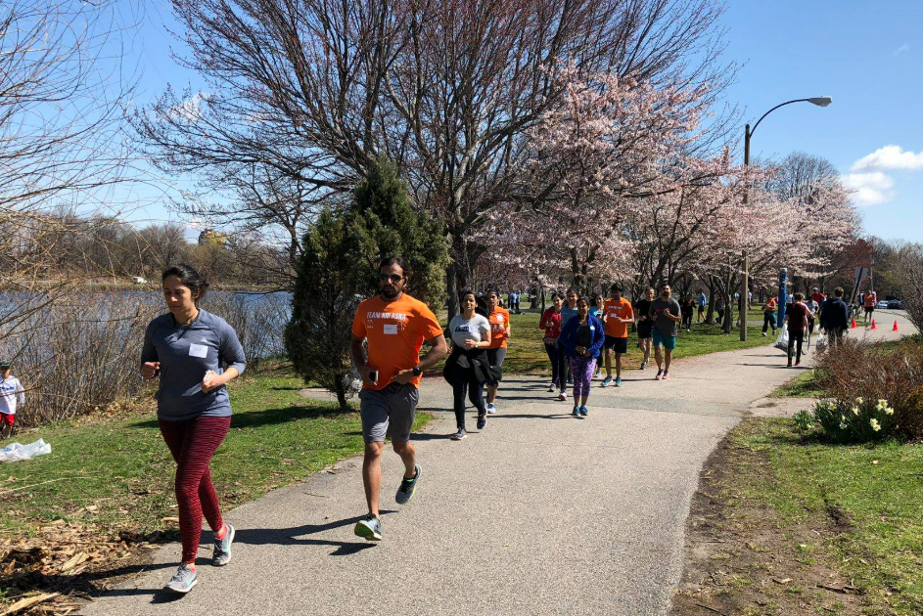
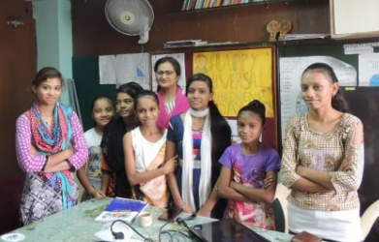
TeamAIDAsha
2026 Half & Full Marathon Program
Information Session
April 5, 2026

Slide 2
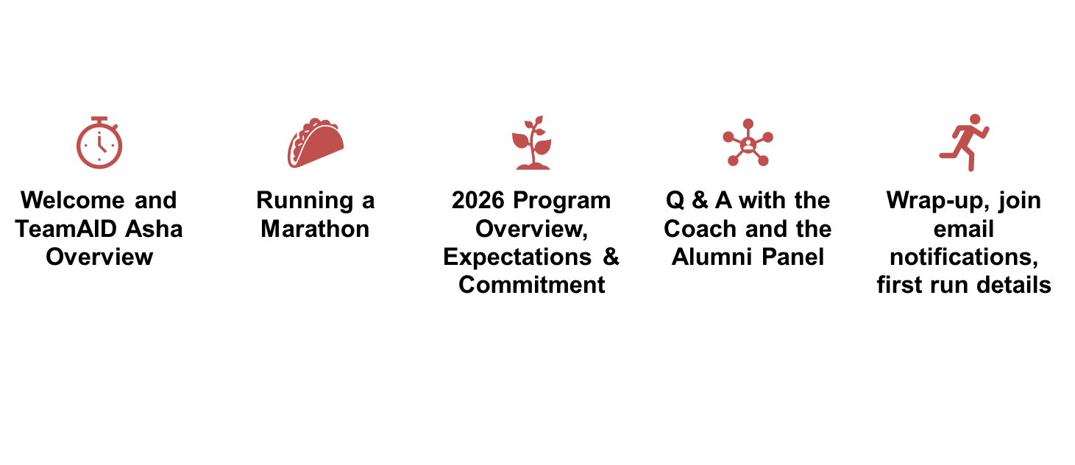
Agenda

Slide 3
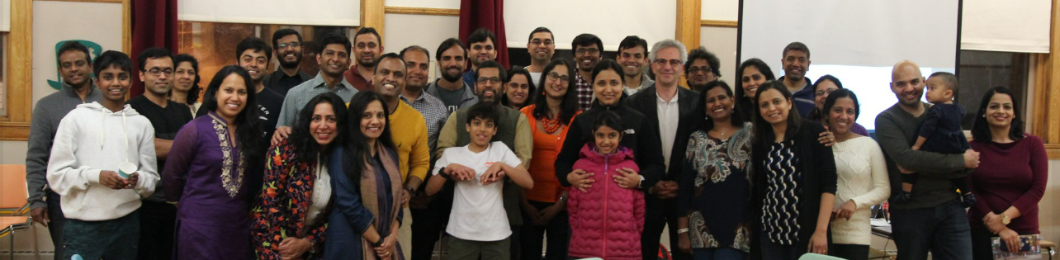
TeamAIDAsha: Making a Difference since 2003
20+ yrs.
in the Community
500+ Runners
Trained
$1M+ Raised for Grassroots Projects
100% Finish Rate

Slide 4
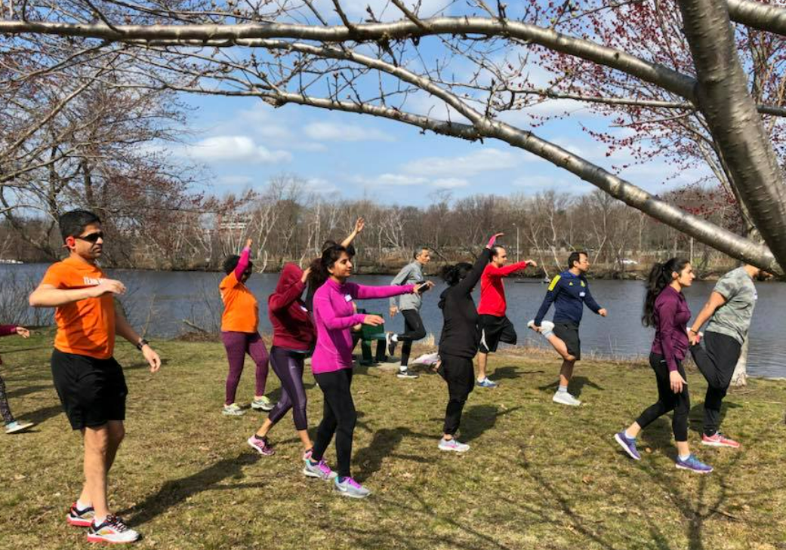
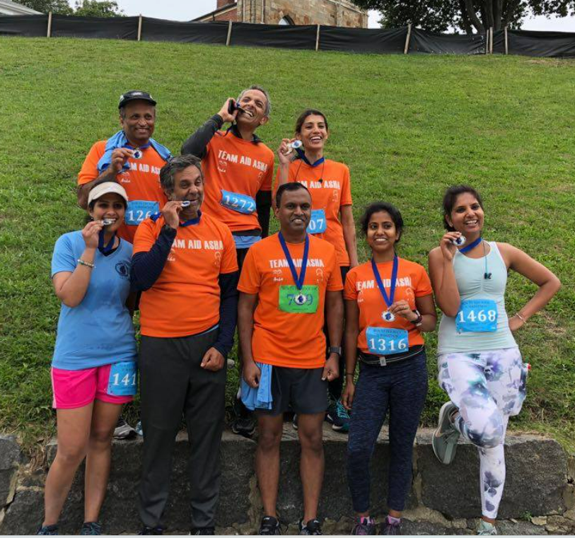
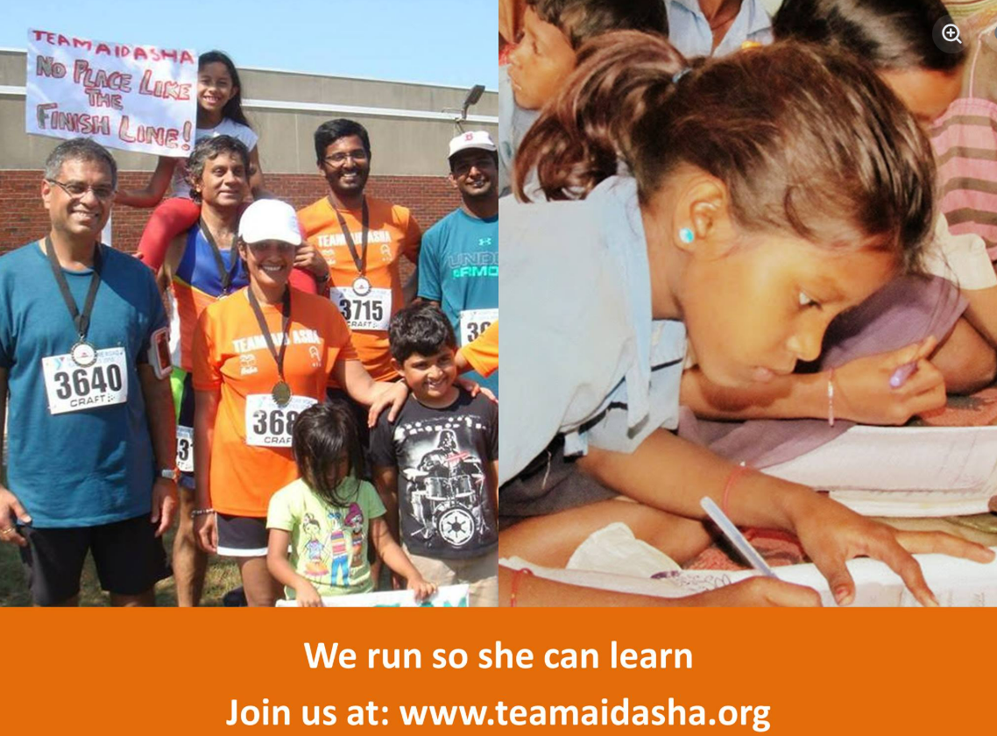
Run with purpose…
make deep impact
Train for a Half or Full Marathon
Reach the finish line in 6 months
All Fitness Levels Welcome
Structured program to support you
All funds raised by you go towards
supporting AID & Asha projects in India

Slide 5
About AID & Asha
Both are US-based 501(c)(3) nonprofits
Entirely volunteer-run & very low administrative costs
4-Star Charity Navigator ratings for financial accountability and transparency
AID — Association for India’s Development
Founded at the University of Maryland in 1991. Works across education, livelihoods, agriculture, natural resources, public health, women's empowerment, and social justice in India’
aidboston.org
Asha for Education
Founded at UC Berkeley in 1991.
Focused exclusively on basic education for underprivileged children in India.
aidboston.org

Slide 6
Asha Worldwide By the Numbers (2025)
$4.02M+
Funds raised
$3.23M+
Funds distributed to projects
148
Asha projects supported
46
Asha chapters
1500+ Volunteers worldwide
216K+
Children served
50K+
Volunteer hours
https://ashanet.org

Slide 7
Asha Boston By the Numbers (2025)
$110K+
Funds raised
$110K+
Funds distributed to projects
10
Projects supported
15+ Volunteers
1500+
Volunteer hours
2000+
Children served
https://boston.ashanet.org

Slide 8
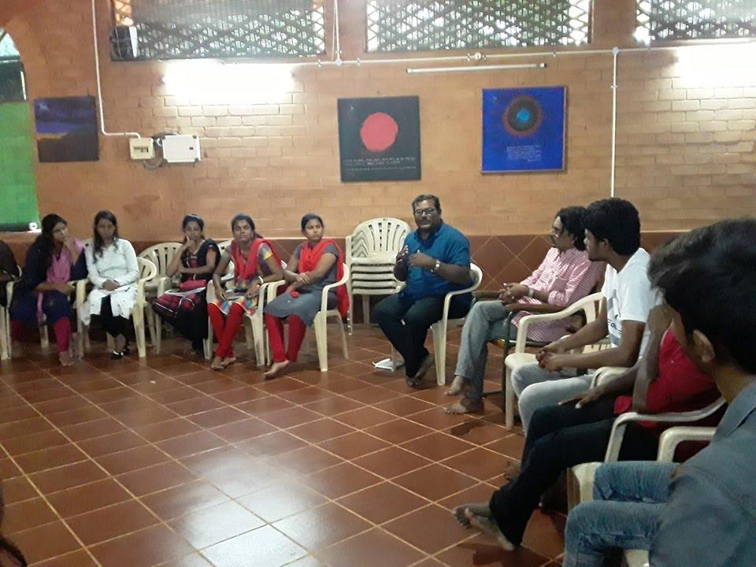
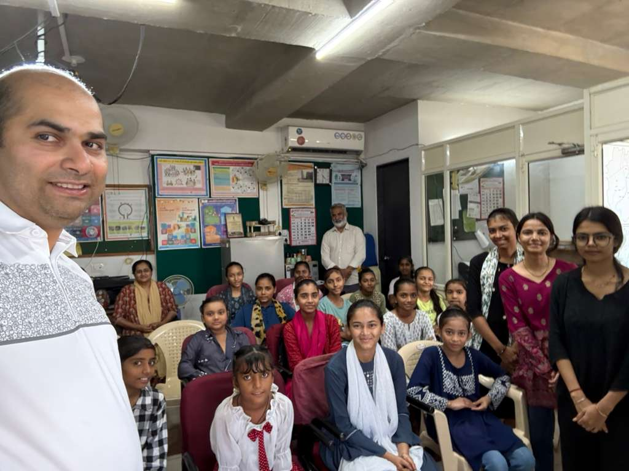
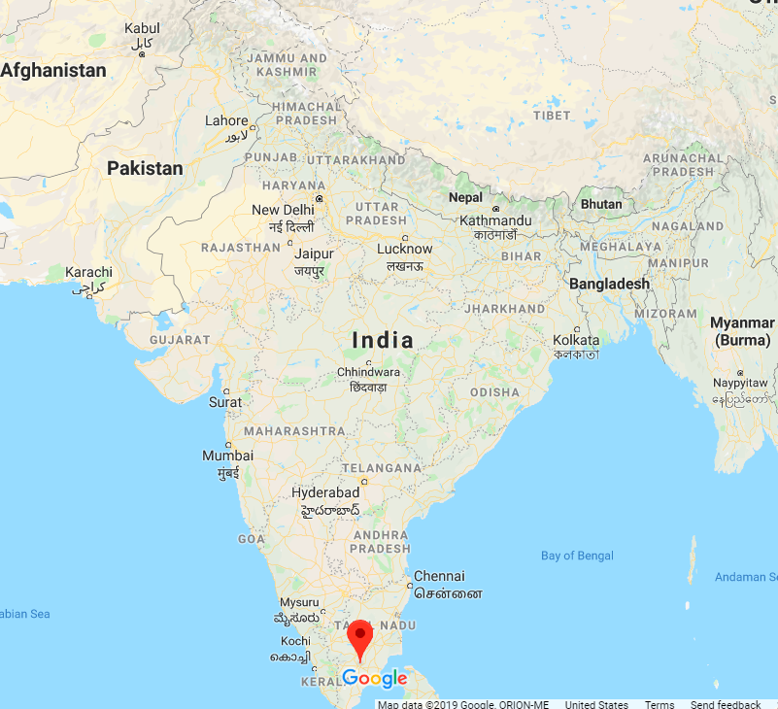

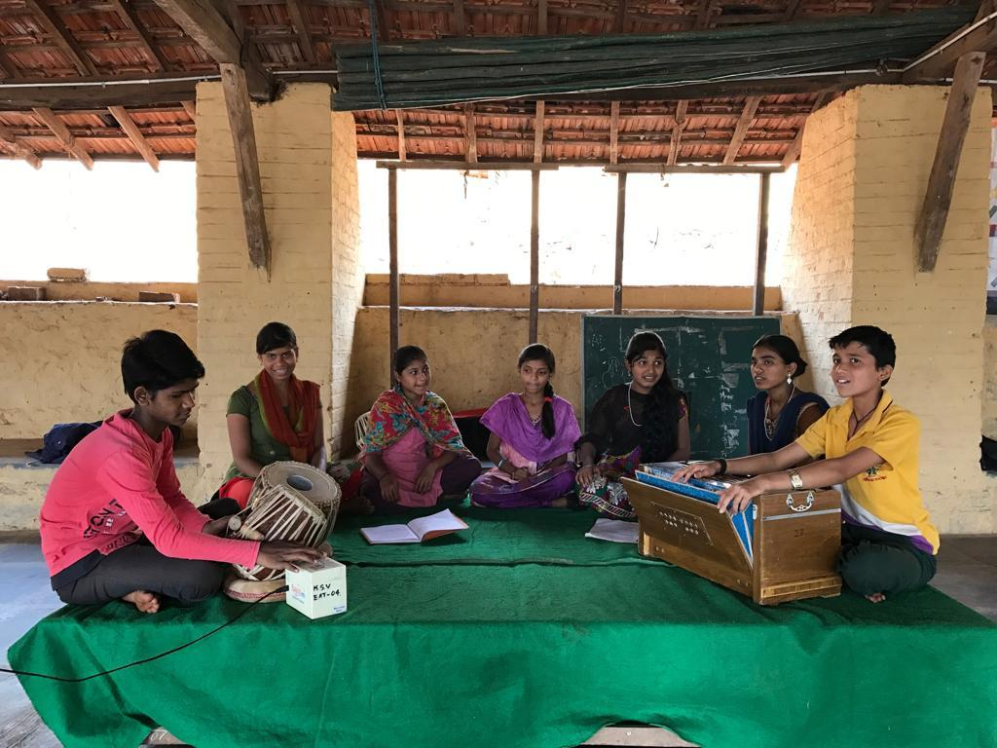
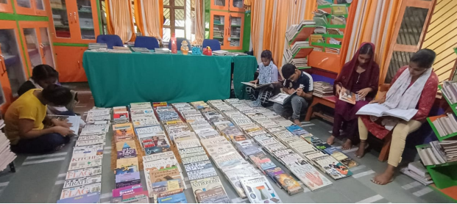
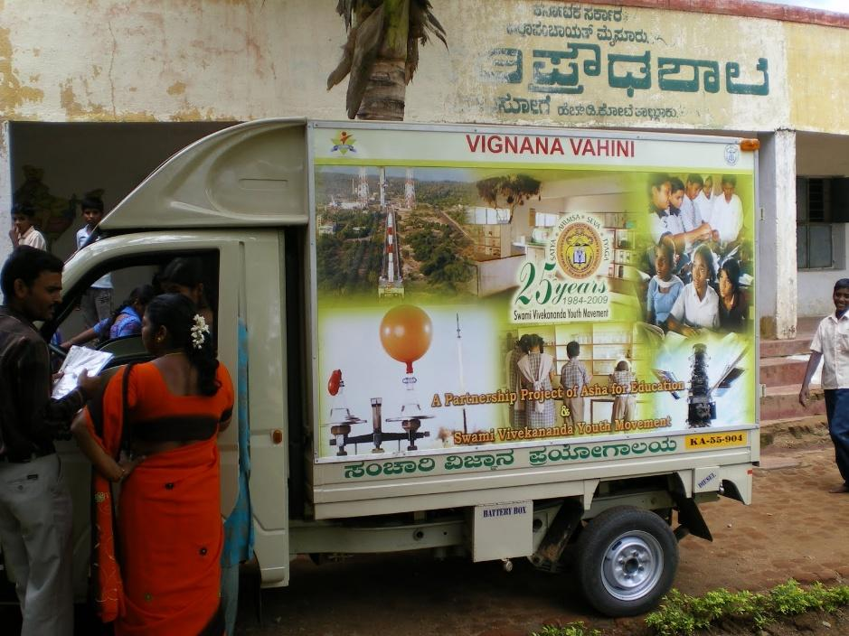
Asha for Education, Boston Chapter https://boston.ashanet.org
SEED, Madurai
Girls Education Initiative
Kalkeri Sangeet Vidyalaya
Asha Library, Varanasi
Mobile Science Van

Slide 9
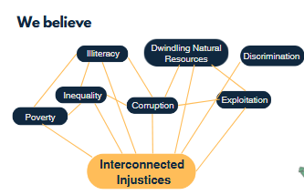
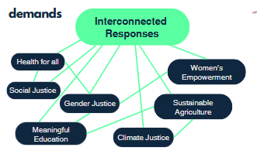
Association for India’s Development Boston
www.aidboston.org
We have Learned that Problems are Interconnected, and hence
Solutions also need to be interconnected!
Notes:
AID believes that interconnected problems of illiteracy, poverty, inequality, corruption, dwindling natural resources, discrimination an exploitation need to be tackled in a holistic way with interconnected solution that it works on with a philosophy of working on public health, meaningful education gender/social and climate justice, agriculture and women’s empowerment. They have a philosophy of working with marginalized community with an outlook of bottom up sustainable development where there is a strong community ownership of the intervention to live a life of dignity and hope in these communities.

Slide 10
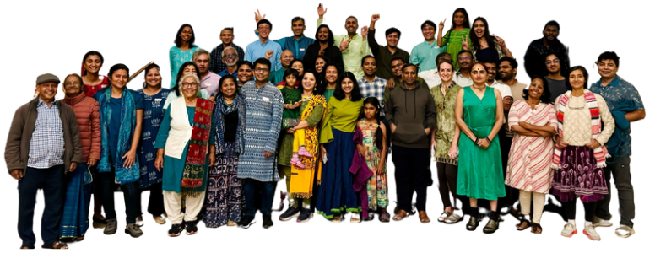
AID India
https://www.aidindia.org
Founded: 1991
Chapters in the US: 20
Number of Volunteers: 800+
Total Supported Projects: 625+
Ongoing Projects: 125+
Projects Visited by AID volunteers: All
$3.3 Million
Grassroot Project support in 2025
Notes:
AID India started in 1991 in University of Maryland by a bunch of Indian Phd students who did not just want to sit and complain but wanted to be part of the solution. They started with education initially but went on to work in overall sustainable and equitable development where no one is left behind. There are many chapters across the US and Boston is one of the bigger chapters in the US. All projects are visited by AID Volunteers from a learning perspective and it has been a transformational experience for them.

Slide 11

AID Boston By the Numbers (2025)
$265K
Grassroot Project Support
20+
Volunteers
8 States
(Delhi, Gujarat, Jharkhand, Karnataka, Odisha, Rajasthan, Uttar Pradesh, West Bengal)
Virtual/In person Meetings
Every Sunday - join us!
All Projects visited by Volunteers
https://www.aidboston.org
Notes:
AID Boston has several projects with a focus on sustainable, equitable and just development for all. In 2025, we dispersed $263K working with grassroot partners in 8 states and we are looking to expand out work in Uttarakhand and Kerala this year. We meet virtually and in person every Sunday - our project partners are invited to talk to us virtually about the work they are doing and our projects are also all visited by volunteers.

Slide 12
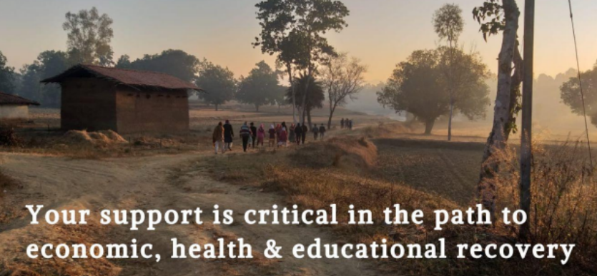
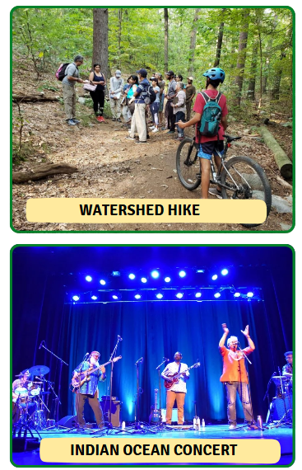
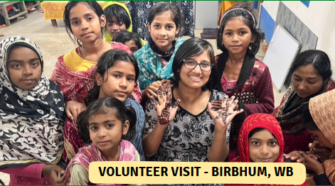
Association for India’s Development Boston
www.aidboston.org
Notes:
Since we have over 15 projects, we look forward to engaging on the project details during our runs. Here is a photo of a new volunteer, Sarani who visited our project in Birbhum which focuses on stopping child marriage with education, leadership and livelihood. We also have volunteer events like watershed hikes to connect the watershed projects in India to our local terrain so that volunteers can understand our work in an experiential way and we get to be together outdoors. Last year, we also have the Indian Ocean rock fusion concert as a fundraiser. Here are just a glimpse of the work that is happening at the chapter level.

Slide 13
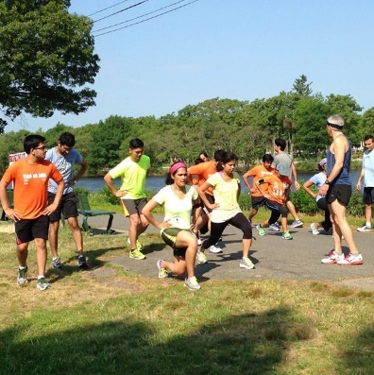
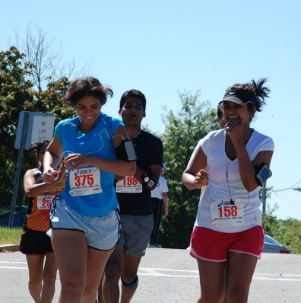

Who can join TeamAIDAsha?
Complete Beginners
Never run a mile in your life? Perfectly fine!
Experienced Runners
Looking for community and purpose
Anyone who wants their efforts to create real change in the world

Slide 14



Why Run with TeamAIDAsha?
Train and race alongside a supportive, motivated group
Community
Structured training plan plus guidance on pacing, stretching, fueling, hydration, fundraising, race prep.
Coaching
Help bring a meaningful change in the world
Impact

Slide 15
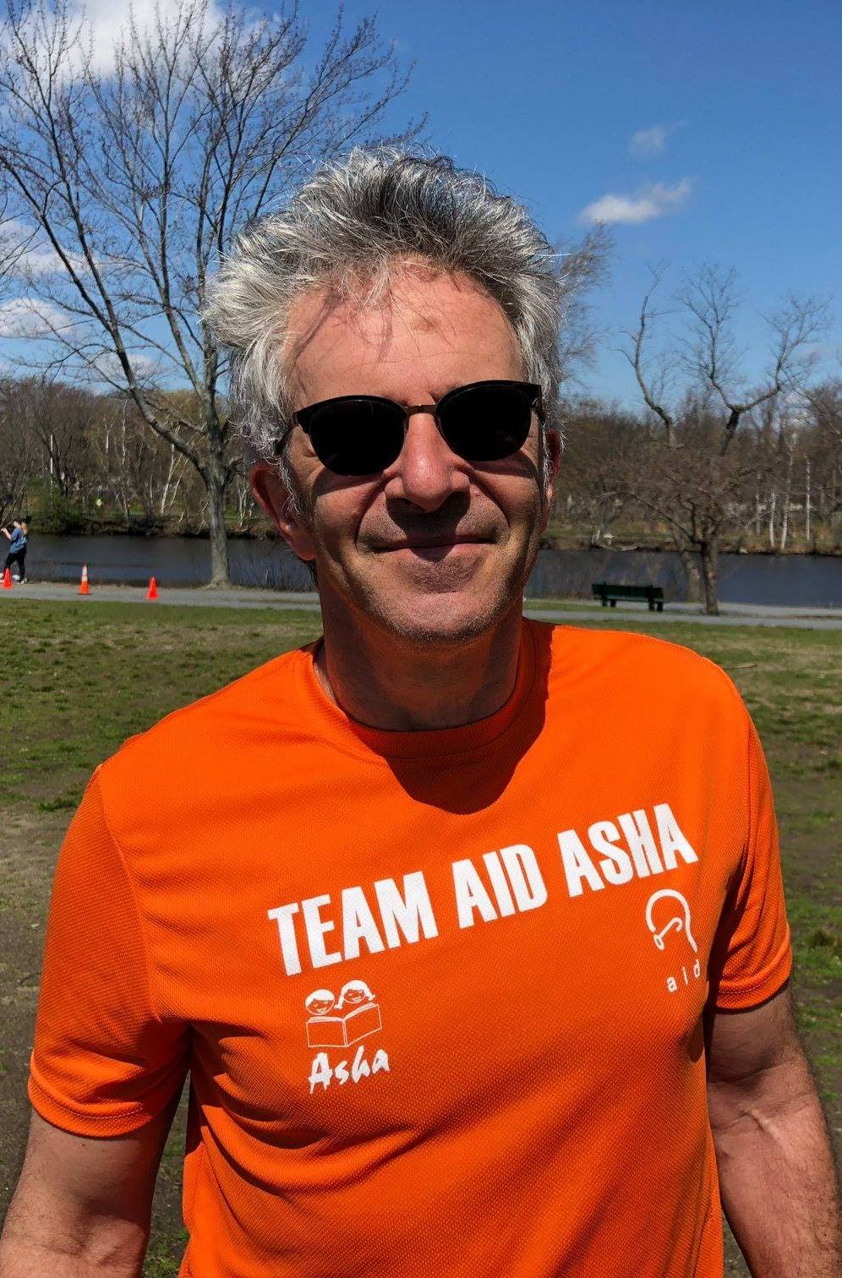
Jonathan Wyner
Head Coach
Founding member TeamAIDAsha
Certified (Road Runners Club of America)
40+ years of running
20+ marathons
Chief Eng : M-Works
  Grammy nominated
HATI and Professor: Berklee College of Music
AI and Audio tech consultant iZotope/SUNO
Jonathan Wyner
jonathan@m-works.com

Slide 16
Running a (half) marathon changes lives. It’s a simple fact.
Improves your fitness
Instills a new self image
Inspires others around you to take on their own challenges
Jonathan Wyner jonathan@m-works.com

Slide 17
Training overview
KEY ELEMENTS
Gradual buildup
Consistency
Accountability of the group
Running pace does not matter!

Slide 18
What does the training entail?
The plan is to gradually buildup mileage. Your body takes time to adapt to the stresses of training for a marathon
Adaptation to a new exercise load
  Cardio-vascular system 3-6 weeks
  Muscular system about 3 months
  Skeletal system 3-6 months
The KEY run each week is the long run
Jonathan Wyner jonathan@m-works.com

Slide 19
What does the training entail?
The plan is to gradually build up mileage. Your body takes time to adapt to the stresses of training for a marathon
Week 1-9 base building
Week 10-16 strength building
Week 17-21 speed and strength
Week 21-24 taper phase
Jonathan Wyner jonathan@m-works.com

Slide 20
What does the training entail?
During the peak (8 weeks) of your training you can expect to invest between 2 and 4 hours per week in your half marathon training
Jonathan Wyner jonathan@m-works.com

Slide 21
What do you get from the training?
You’ll get to ask and receive feedback on important questions such as
  How do I breathe?
  Do you think I could win the Boston Marathon?
Jonathan Wyner jonathan@m-works.com

Slide 22
What do you get from the training?
You’ll enhance your vocabulary with exotic words such as
  “hyponatremia” and “GU”
Jonathan Wyner jonathan@m-works.com

Slide 23
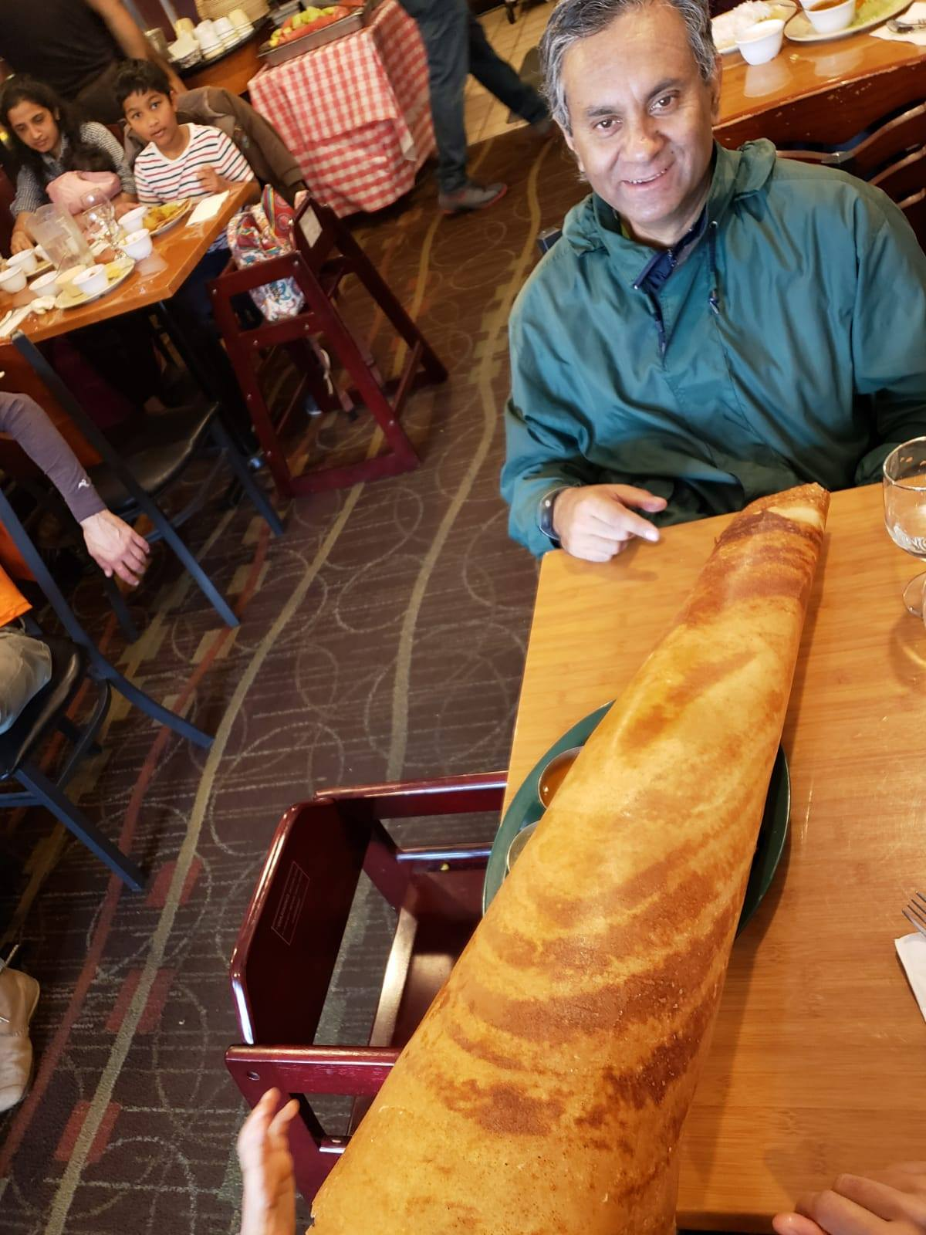
What do you get from the training?
You’ll learn a new meaning for the term “calories” (It’s a beautiful thing!)
Jonathan Wyner jonathan@m-works.com

Slide 24
What do you get from the Training?
Training and coaching using a plan devised specifically for your marathon
Group runs with logistical support
Email support with me during the program
You’ll find a resource in the experience of other runners who have already completed the marathon
Jonathan Wyner jonathan@m-works.com

Slide 25
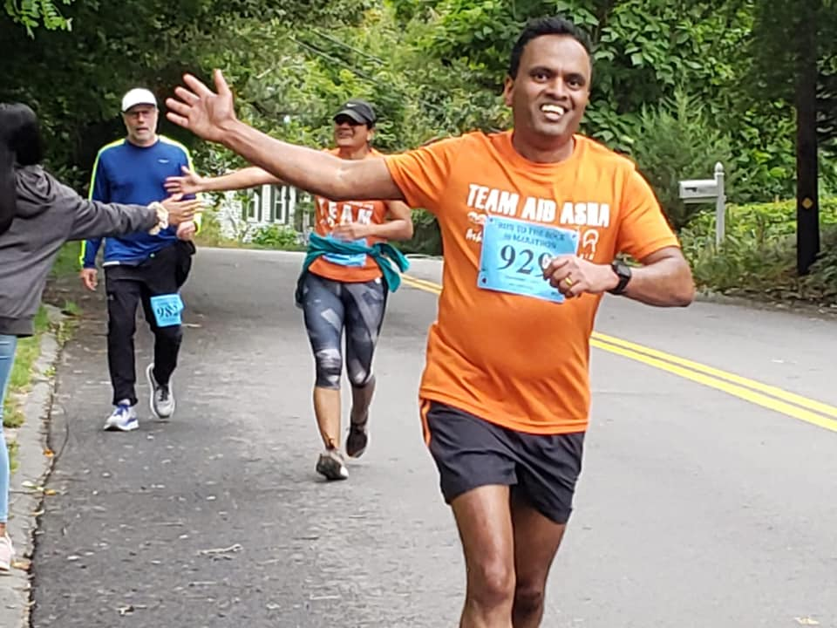
Half Marathon Program
In many respects identical to the full marathon program with a slightly shorter training period and lower mileage targets
Jonathan Wyner jonathan@m-works.com

Slide 26
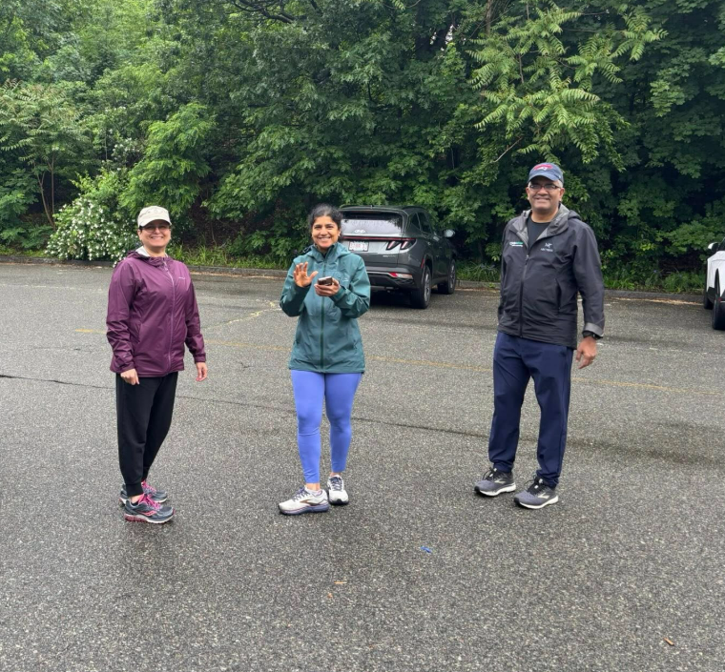
Walk Half Marathon: Pilot
For those who prefer to power-walk the half marathon distance
Still a pilot - talk to us if you're interested
Jonathan Wyner jonathan@m-works.com

Slide 27
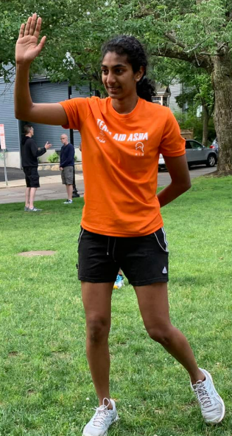
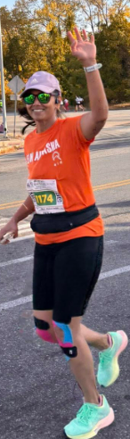
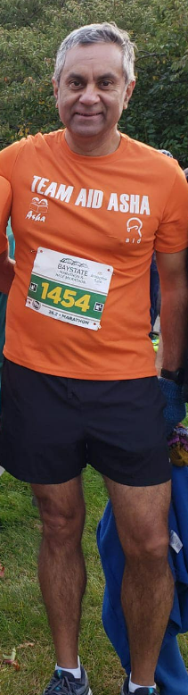
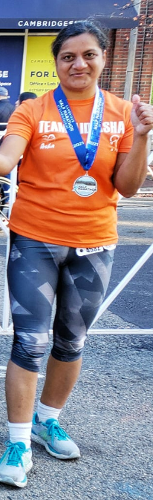
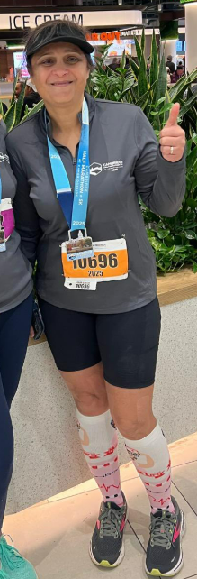
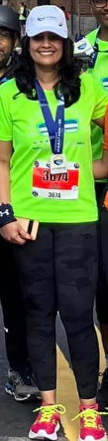
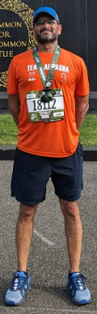
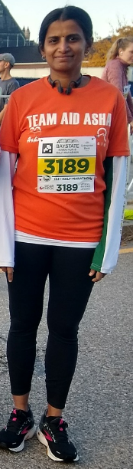
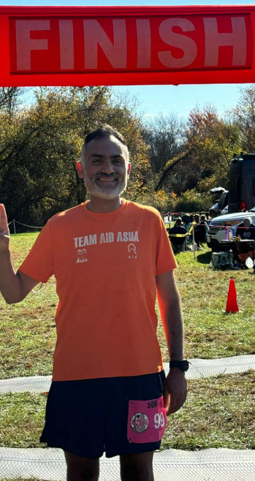
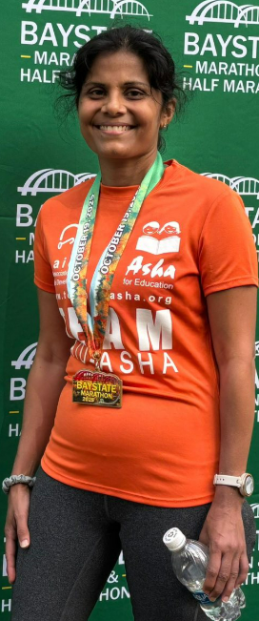
Assistant / Alum Team Guides
Lakshmi
Kavitha
Manisha
Priya
Somnath
Vijay
Ruta
Sameer
Kalpana
(&)
Lakshmi

Slide 28
Your Commitment &
Program Support

Slide 29
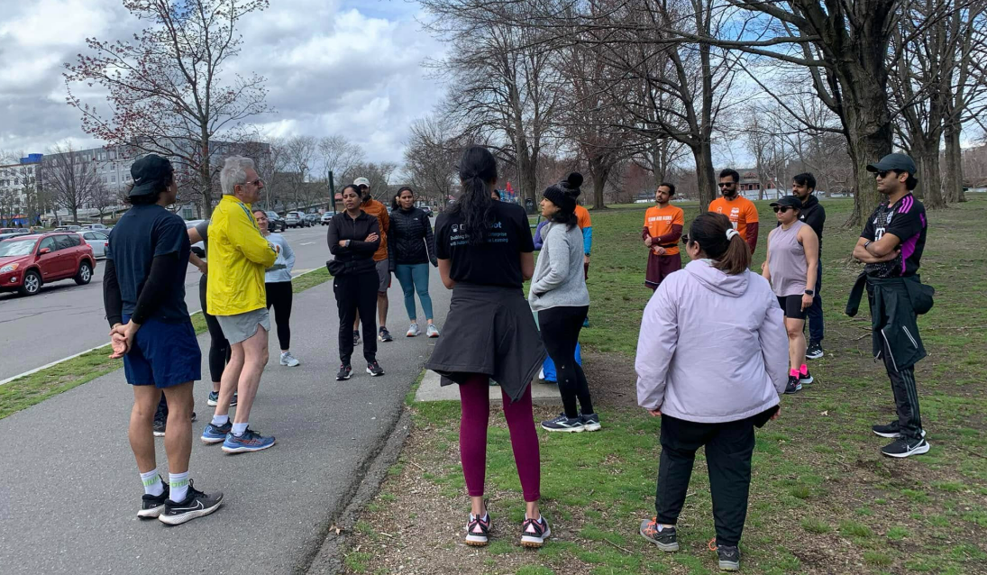
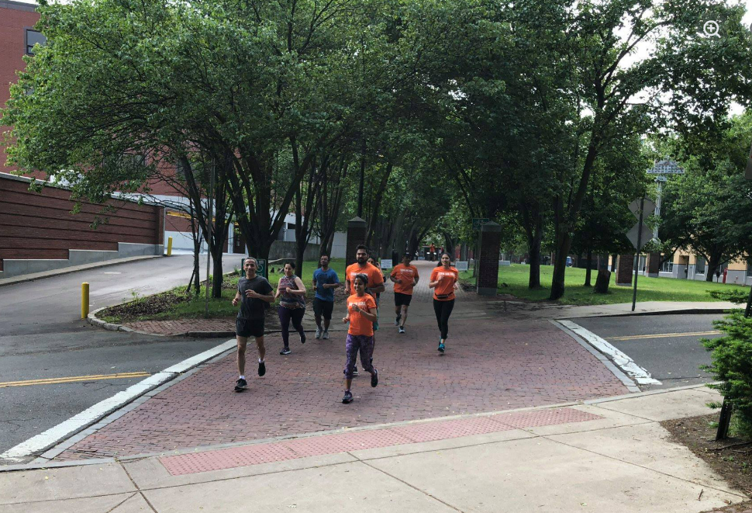
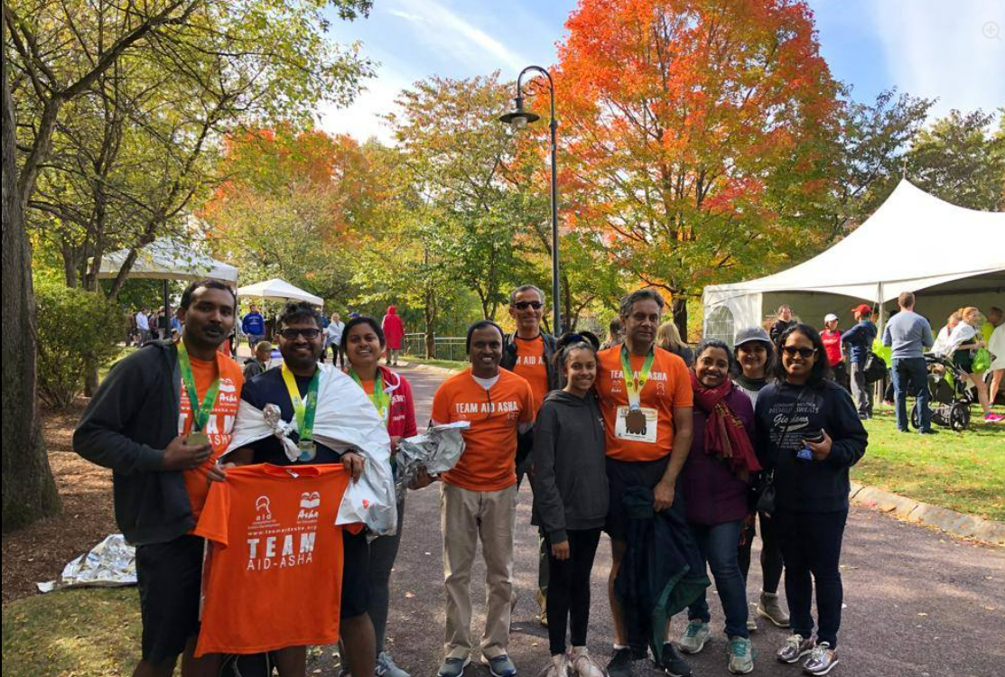
2026 Calendar
April: Info session, begin training
April-October: Group run every Saturday morning. Train/cross train on your own through the week (there is a plan to follow)
May: Register with TeamAIDAsha
May/June: Attend the clinics
July-October: Fund raising
October-November: Your Half / Full Marathon Race!
Group runs:
-Boston-Cambridge, Minuteman (Arlington, Lexington, Bedford), Bruce Freeman (Acton)
-Start time: initially 9 am/7 am or 6:30 during peak summer long runs

Slide 30

Fundraising Targets
Half Marathon Minimum Target: $1500
Full Marathon Minimum Target: $2620
Alum & Student Minimum Target: $1000
2 or more runners from the same family: 25% off total target
Success in reaching your target is guaranteed
…when you follow our fundraising guidelines

Slide 31
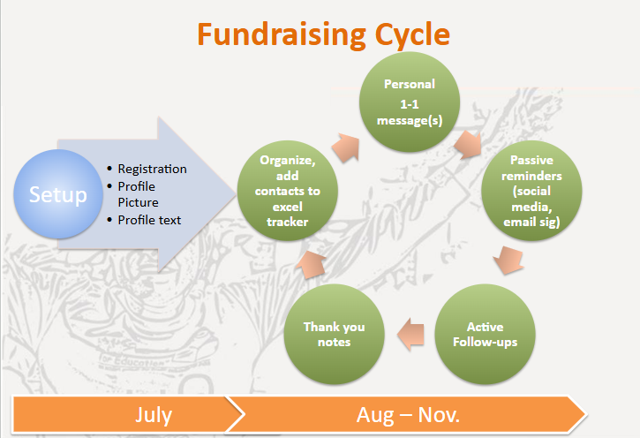
Fundraising Clinic
Best practices for fundraising: 20+ years of accumulated wisdom
Proven by 500+ successful alumni
Exceed the fundraising target by following our best practices

Slide 32
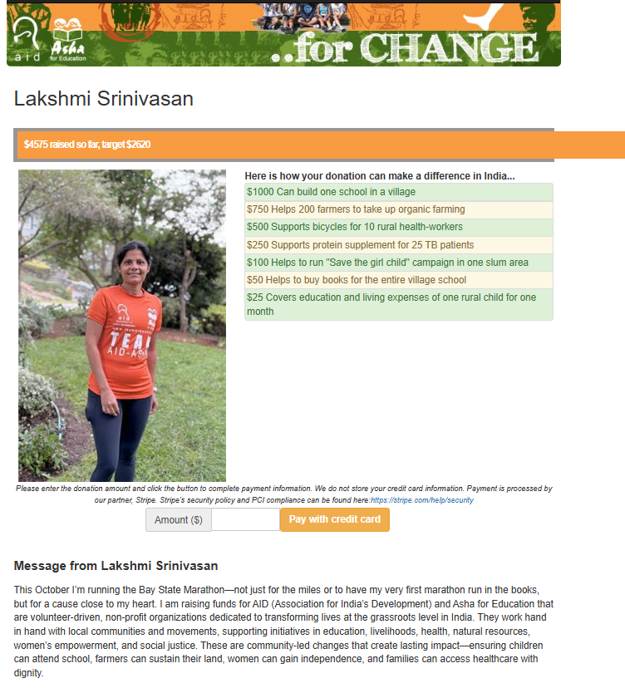
Personalized Fundraising Page
Personalizable, self-serve
Automated credit card donations
100% secure & PCI compliant
Mobile and web donations

Slide 33
Runner Expenses (estimated)
Race registration fees (~50-200$ per race)
Travel and accommodation to race locations
Shoes for training & your race (1 to 2 pairs), running apparel & any accessories you may choose

Slide 34
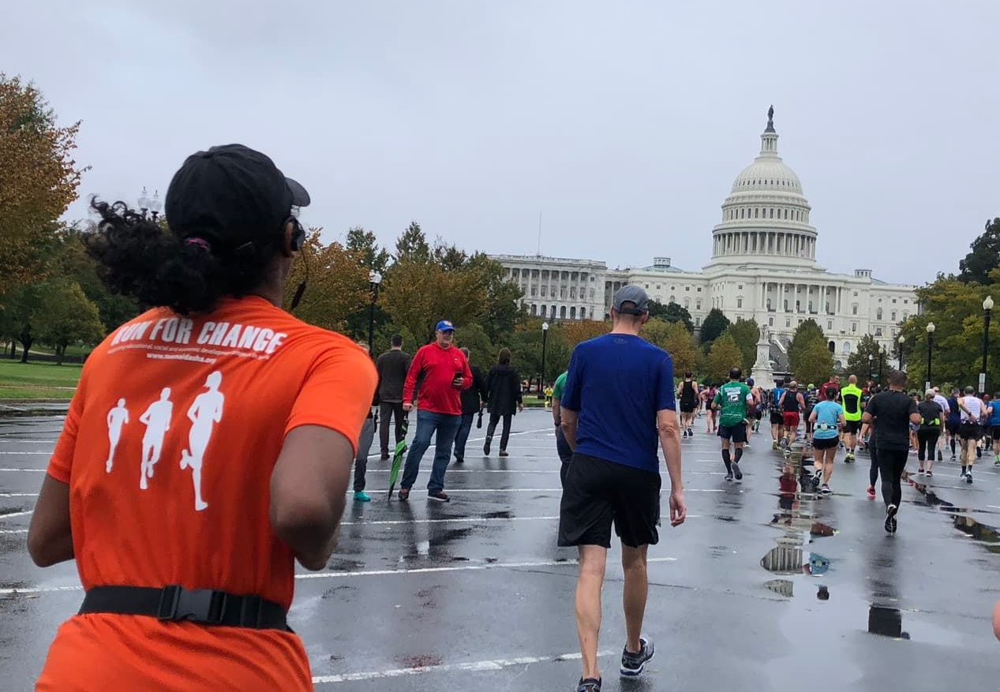
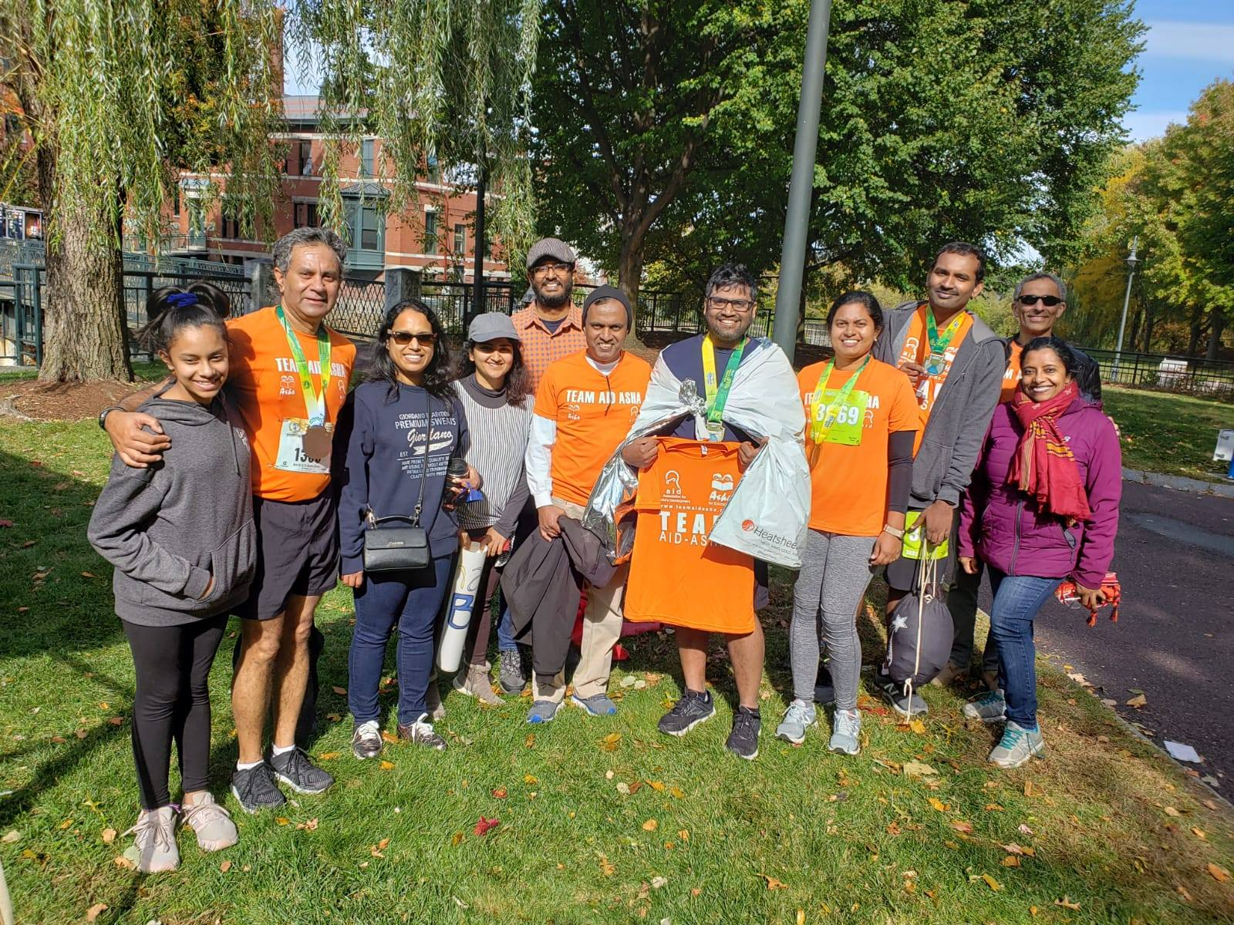
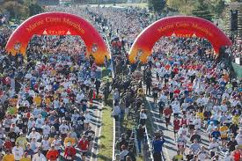
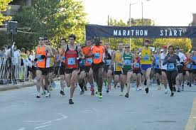
Race Options
(Registration open for many of these)
Baystate Half/Full Marathon - Lowell, MA (Sun, Oct. 18)
Marine Corps Full Marathon - Washington DC (Sun, Oct. 25)
Cambridge Half Marathon - Cambridge, MA (Sun, Nov. 1)
You register for your race on your own
Interested in others races in the Fall? Talk to us about these

Slide 35
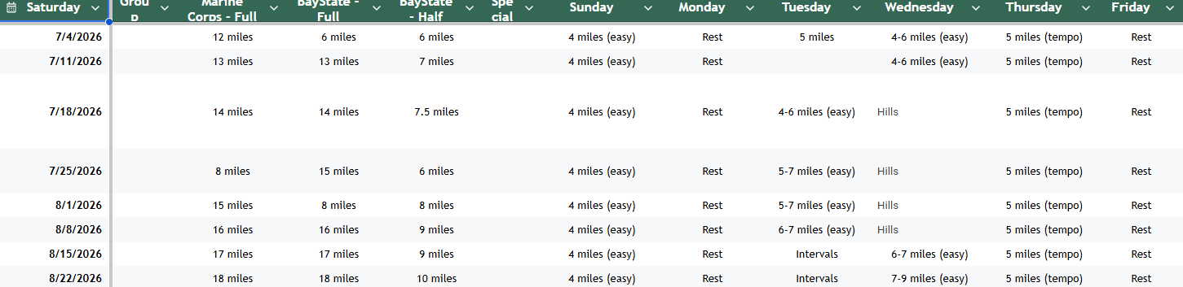
Detailed Training Plan
Google spreadsheet shared with you
Weekly training schedule

Slide 36
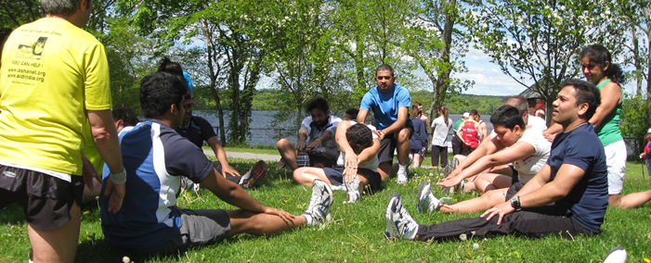
Stretching
Pre-run warm-up stretches
Post-run cool-down stretches
Core strengthening stretches
Injury prevention stretches

Slide 37
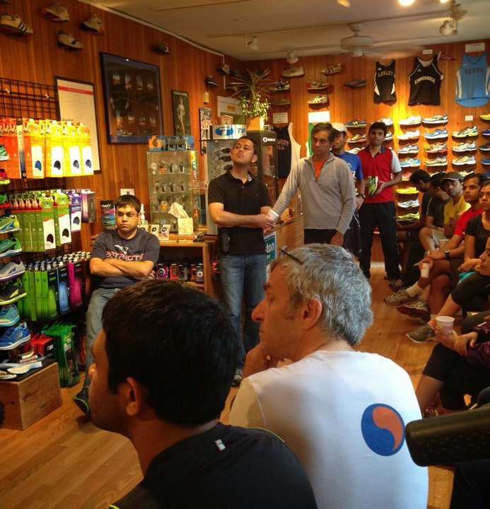
Shoe Clinic
Private Clinic for TeamAIDAsha runners at Marathon Sports, Cambridge
Biomechanics, gait analysis & shoe fitting
Running accessories & apparel
Q&A
Special discounts for purchases

Slide 38
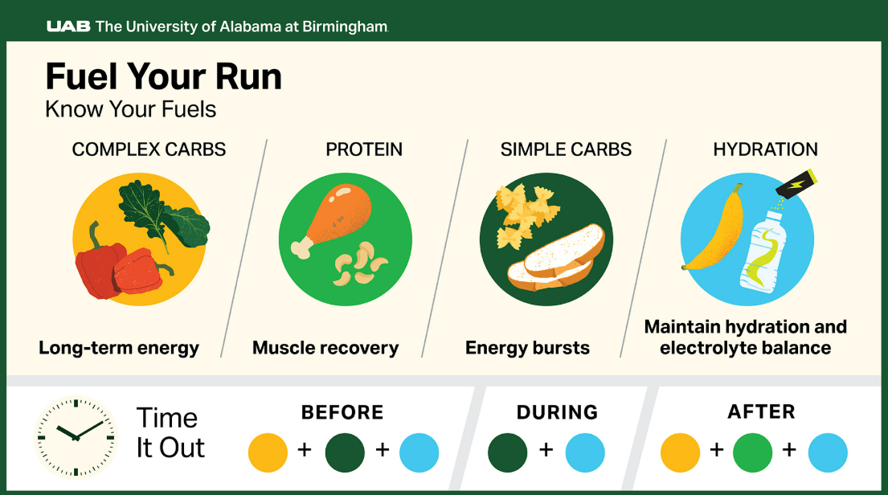
Nutrition Clinic
Runners plate
Before the long run
During the run
Gatorade, Gu Gels,…
After the run

Slide 39
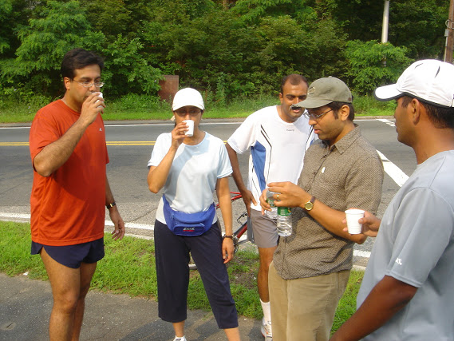

Hydration Support for Saturday Group Runs
Organized by AID/Asha and TeamAIDAsha alumni volunteers
Water and/or Gatorade
Approximately every 3 miles

Slide 40
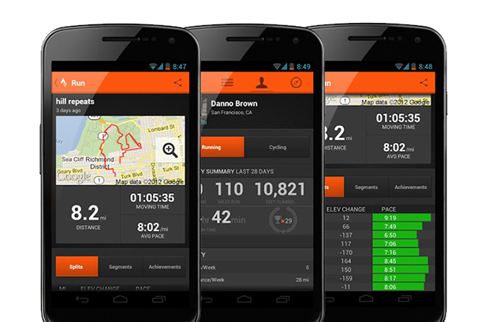

TAA Strava Club
Strava – free mobile app to track personal training
Private Strava club - Stay motivated by fellow runners
Get personalized advice from coaching assistants

Slide 41


Socials
Outdoor & indoor fun gatherings
Runners, volunteers, alumni
Bring your friends / family
Organize one yourself
Make friends for life!

Slide 42

Coach
Q&A
Jonathan Wyner
jonathan@m-works.com

Slide 43
Alum Runners Panel:
Ask us anything!

Slide 44

Join Us For First Training Run/Walk
Saturday, April 11, 9:00AM
[1225 Soldiers Field Rd, Boston, MA]
Multiple distance groups
[choose 2, 3, 4 or miles]
Run/walk options
[coaching assistants for each group]
Sign up to receive notifications about our Saturday group runs

Slide 45
THANK YOU!

